Slide 1
Boolean Algebra

Slide 2
Index
Boolean Variable and Functions
Sum-of-Products and Product-of-Sums Forms
Axioms and Theorems
Derivation of the POS form
Perfect Induction
Simplifying Equations
Schematic
Programmable Logic Array
Drawing rules
Multiple-output circuits
Multilevel Combinational Logic
Bubble Pushing
X and Z

Slide 3
Boolean Variable and Functions (1)
Let X be a certain discreet variable, we call boolean variable any discreet variable that can assume only two values:
X = 0 False
X = 1 True
If we have the boolean variables X₁, X₂, . . ., X_{n}
f (X1, X2, . . . , Xn) is called a boolean function
it can assume only the values 0 and 1
associates a boolean value to every element in its domain
The domain of a function of n-variables is composed of all the 2^{n} combinations of their values
domain’s elements are countable
Two functions are equivalent if they assume the same value for any combination of their variables values

Slide 4
Boolean Variable and Functions (2)
_
The complement of a variable A is its inverse A
we call A the true form of the variable A
and A the complementary form
Literals are the number of element that make up a boolean expression (not to be confused with the number of variables)
fF(A, B) is a logical function with two binary variables A and B
F = A + B has 2 literals
F= AB + BA has 4 literals
The AND of one or more literals is called product (or implicant)
AB, ABC, and B are all implicants
A minterm is an implicant involving all the inputs to the function
ABC is a minterm for a function of the three variables A, B, and C
The OR of one or more literals is called a sum
A maxterm is a sum involving all the inputs to the function
A + B + C is a maxterm for a function of the three variables A, B, and C
_
_
_

Slide 5
Boolean Variable and Functions (3)
The order of operations is important when interpreting equations
NOT has the highest precedence
followed by AND, then OR (just as in ordinary equations)
Y = A + BC means Y = A OR (B AND C)

Slide 6
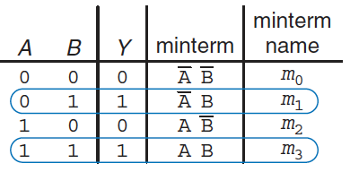
Sum-of-Products Form (SOP) (1)
A truth table of N inputs contains 2^{N} rows
one for each possible value of the inputs
We can associate each row with a minterm that is TRUE for that row
Example of two inputs:
the minterm for the first row is A B because it is TRUE when A=0, B=0
The minterms are numbered starting with 0 (m₀, m₁, m₂, and so on)
We can write the boolean equation by summing each of the minterms for which the output is TRUE
in the example, there are two rows (or minterm) for which the output is TRUE
thus, Y = A B + A B
This is called the sum-of-products (SOP) canonical form of a function, because it is the sum (OR) of products (AND). In sigma notation:
F(A,B) = 𝛴(m₁, m₃)
_
_
_

Slide 7
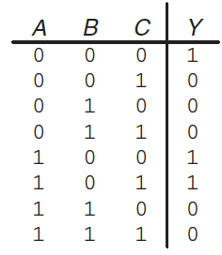
Sum-of-Products Form (SOP) (2)
The sum-of-products form provides a boolean equation for any truth table with any number of variables:
Y = A B C + A B C + A B C = 𝛴(m₀,m₄,m₅)
Unfortunately, sum-of-products form does not necessarily generate the simplest equation
m₀: A B C
m₁: A B C
m₂: A B C
m₃: A B C
m₄: A B C
m₅: A B C
m₆: A B C
m₇: A B C
_
_
_
_
_
_

Slide 8
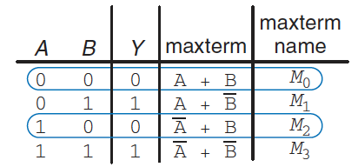
Product-of-Sums Form (POS) (3)
An alternative way of expressing boolean functions
We associate each row of a truth table with a maxterm that is FALSE for that row
Example of a two input:
the maxterm for the first row is (A + B) because it is FALSE when A=0, B=0
We can write the boolean equation as the AND of each of the maxterms for which the output is FALSE
in the example, there are two maxterm for which the output Y is FALSE
thus, Y = (A+B) (A+B)
This is called the product-of-sum (POS) canonical form of a function. In pi notation: F(A,B) = π(M₀, M₂)
even, POS form does not necessarily generate the simplest equation
SOP produces a shorter equation when the output is TRUE on only a few rows
POS is simpler when the output is FALSE on only a few rows
_

Slide 9
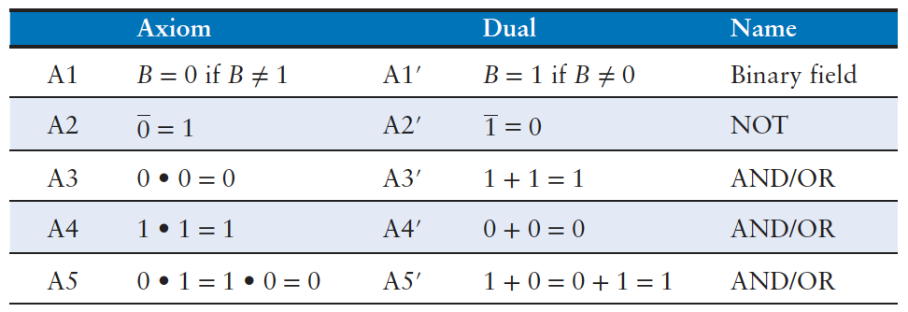
Axioms
We learned how to write a boolean expression given a truth table
that expression does not necessarily lead to the simplest set of logic gates
We can use boolean algebra to simplify boolean equations
rules are much like those of ordinary algebra
in some cases, simpler, because variables have only two possible values
Based on a set of axioms that we assume as correct
five axioms define boolean variables and the meanings of NOT, AND, and OR
principle of duality: if the symbols 0 and 1 and the operators • (AND) and + (OR) are interchanged, the statement will still be correct

Slide 10
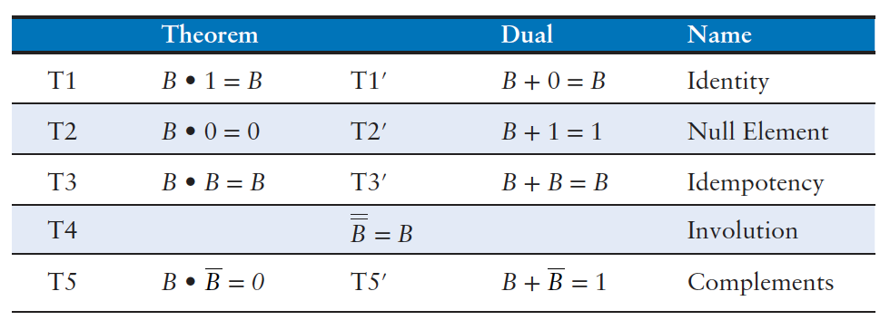


Theorems of One Variable (1)
Describe how to simplify equations involving one variable:
T1 Identity theorem
if one input of a two-input AND gate is always 1, we can remove the AND gate and replace it with a wire connected to the variable input
if one input of a two-input OR gate is always 0, we can replace the OR gate with a wire connected to B
Gates cost money, power, and delay, so replacing it with a wire is beneficial!

Slide 11




Theorems of One Variable (2)
T2 Null element theorem
B AND 0 is always equal to 0 (null element for the AND operation because it nullifies the effect of any other input)
if one input of an AND is 0, we can replace the AND with a wire that is tied LOW
B OR 1 is always equal to 1 (null element for the OR operation)
if one input of an OR is 1, we can replace the OR with a wire that is tied HIGH
T3 Idempotency theorem
a variable AND/OR itself is equal to just itself
idem (same) and potent (power)
permits replacing a gate with a wire

Slide 12



Theorems of One Variable (3)
T4 Involution theorem
complementing a variable twice results in the original variable
two inverters in series logically cancel each other out and are logically equivalent to a wire
T5 Complement theorem
a variable AND its complement is 0
because one of them has to be 0
a variable OR its complement is 1
because one of them has to be 1

Slide 13
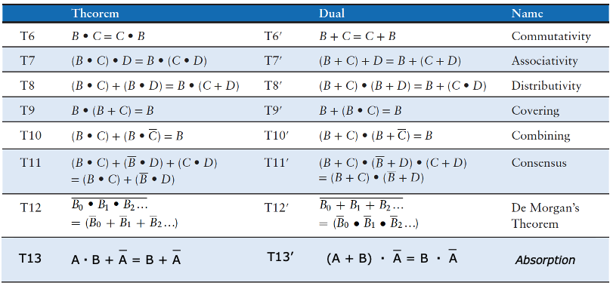
Theorems of Several Variables (1)
Describe how to simplify equations involving more than one variable:
T6 Commutativity and T7 Associativity theorems
work the same as in traditional algebra
the order of inputs does not affect the value of the output
specific groupings of inputs do not affect the value of the output

Slide 14
Theorems of Several Variables (2)
T8 Distributivity theorem
AND distributes over OR
as in traditional algebra (multiplication distributes over addition)
OR distributes over AND
different from traditional algebra
addition does not distribute over multiplication ( (b + c) × (b + d) ≠ b + (c × d)

Slide 15
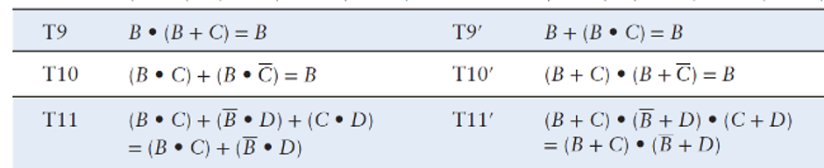
Theorems of Several Variables (3)
T9 Covering, T10 Combining, T11 Consensus theorems, T13 Absorption
permit us to eliminate redundant variables
prove true using other axioms and theorems:
B•(B+C) = B•B + B•C = (T8 Distributivity) = B + B•C = (T3 Idempotency) = B•(1 + C) = (T8 Distributivity) = B•(1) = (T2 Null element) = B (T1 Identity)
B•C + B•C = B•(C+C) = (T8Distributivity) = B•(1) = (T5’ Complements) = B (T1 Identity)
B•C + B = (B+B) • (C+B)= (T8’ Distributivity) = (1) • (C+B) = (T5’ Complements) = C+B (T1 Identity)
_
_
_
_
_
_
_

Slide 16
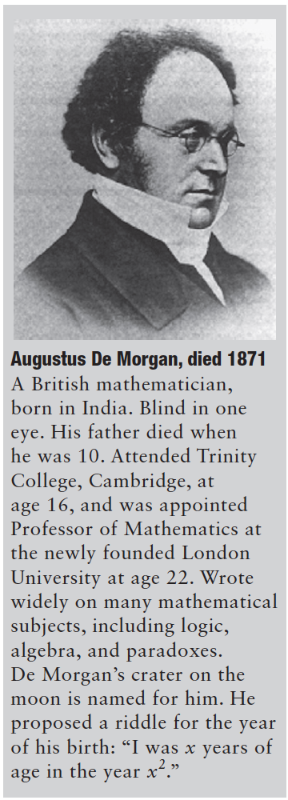
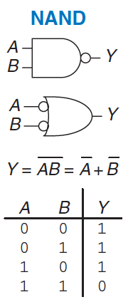
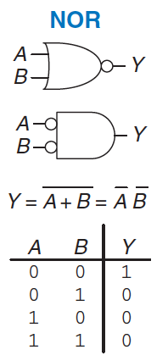
T12 De Morgan’s Theorem
Complement of the product of all terms is equal to the sum of the complement of each term
NAND gate = OR gate with inverted inputs
Complement of the sum of all the terms is equal to the product of the complement of each term
NOR gate = AND gate with inverted inputs
The inversion circle is called a bubble
Intuitively: we can imagine that “pushing” a bubble through the gate causes it to come out at the other side and flips the body of the gate from AND to OR or vice versa

Slide 17
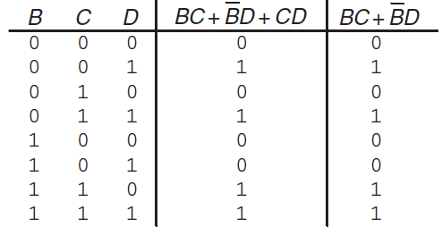
Perfect induction
Proof of theorems with a finite number of variables are easy
just show that the theorem holds for all possible values of these variables
Example: proving the T11 Consensus theorem using perfect induction:
check both sides of the equation (BC + BD + CD = BC + BD) for all eight combinations of B, C, and D
Because BC + BD + CD = BC + BD for all cases, the theorem is proved!
_
_
_
_

Slide 18
Simplifying Equations (1)
Theorems help us simplify boolean equations
example, consider the previously sum-of-products expression Y = AB + AB
by using the T10 Combining theorem the equation simplifies to Y = B
this may have been obvious looking at the truth table
in general, multiple steps may be necessary to simplify more complex equations
The basic principle of simplifying sum-of-products equations is to combine terms using the relationship PA + PA = P, where P may be any term
How far can an equation be simplified?
we define an equation in sum-of-products form to be minimized if it uses the fewest possible products
if there are several equations with the same number of products, the minimal one is the one with the fewest literals
A product is called a prime product if it cannot be combined with any other product in the equation to form a new product with fewer literals
product in a minimal equation must all be prime product
otherwise, they could be combined to reduce the number of literals
_

Slide 19
Simplifying Equations (2)
_
_
_
_
_
_
Minimize A B C + A B C + A B C
Minterms A B C and A B C differ only in A, so we can combine them to form B C
B C + A B C
Notice that also minterms A B C and A B C differ by a single literal, thus we could have combined these two
A B C + A B
Products B C and A B share the minterm A B C
So, are we stuck with simplifying only one of them?
Using the idempotency theorem, we can duplicate terms as many times
T3 Idempotency: A B C + A B C + A B C +A B C
T8 Distributivity: B C (A + A) + A B (C + C)
T5 Complements: B C (1) + A B (1)
T1 Identity: B C + A B
_
_
_
_
_
_
_
_
_
_
_
_
_
_
_
_
_
_
_
_
_
_
_
_
_
_
_
_
_
_
_
_
_
_
_
_
_
_
_
_
_

Slide 20
Simplifying Equations (3)
Why bother simplifying a Boolean equation if it remains logically equivalent?
reduction of the number of gates
make the circuit smaller, cheaper, and possibly faster
Notice that simplifying boolean equations with theorems can take some trial and error, later we describes a methodical technique (Karnaugh maps) that makes the process easier

Slide 21



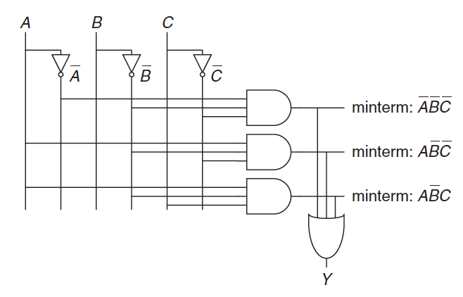
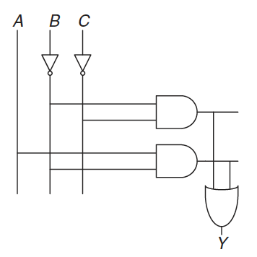
Schematic
A schematic is a diagram of a digital circuit showing the elements and the wires that connect them
Notice that the simplified circuit has significantly less hardware than that of the original equation, it may be faster because it uses gates with fewer inputs

Slide 22
Programmable Logic Array
Any Boolean equation in sum-of-products form can be drawn in a systematic way:
draw columns for the inputs
place inverters in adjacent columns
draw rows of AND gates for each of the minterms
for each output, draw an OR gate connected to the related minterms
This style is called a Programmable Logic Array (PLA) because the inverters, AND gates, and OR gates are arrayed in a systematic fashion

Slide 23
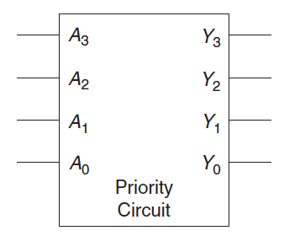
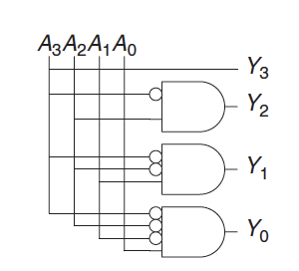
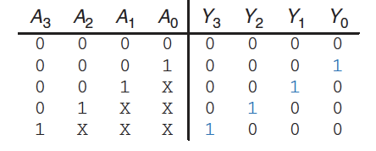
Multiple-output Circuits
Many circuits have multiple outputs
each computes a separate boolean function of the inputs
we can write a separate truth table for each output
or write all the outputs on a single truth table
Example: priority circuit
we can use sum-of-products form and reduce the equations using boolean algebra
however, the simplified equations are clear by inspection
notice that if A₃ is 1, the outputs don’t care what the other inputs are: we use the symbol X
Experienced designer often implement a logic circuit by inspection

Slide 24
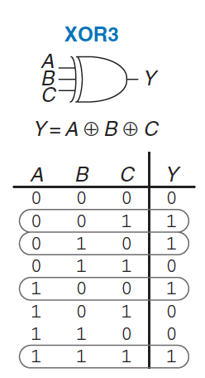
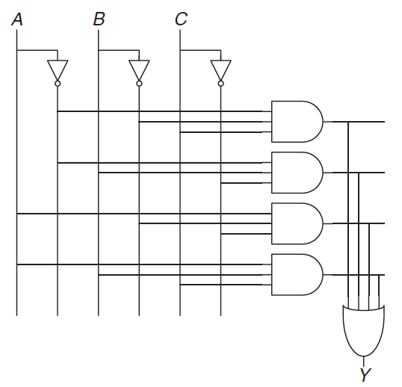

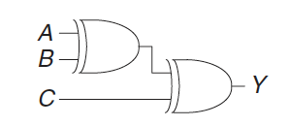

Multilevel Combinational Logic (1)
Logic in sum-of-products form is called two-level logic
it consists of literals connected to a level of AND gates connected to a level of OR gates
some logic functions require an enormous amount of hardware
Example: the XOR function of multiple variables
consider building a three-input XOR using the two-level techniques
an N-input XOR produces a TRUE output when an odd number of inputs are TRUE
On the other hand, notice that:

Slide 25
Multilevel Combinational Logic (2)
Designers often build circuits with more than two levels of logic gates
may use less hardware
However, selecting the best multilevel implementation of a specific logic function is not a simple process: “best” has many meanings
fewest gates, fastest, shortest design time, least cost, least power consumption, etc..
“best” circuit in one technology is not necessarily the best in another
e.g. CMOS circuits prefer NANDs and NORs over ANDs and ORs
With some experience, you will find that you can create a good multilevel design by inspection for most circuits
Computer-Aided Design (CAD) tools are also available to search a vast space of possible multilevel designs and seek the one that fits your constraints given the available building blocks

Slide 26
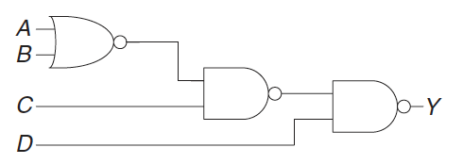
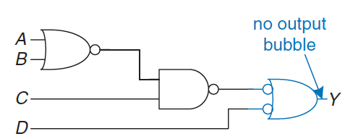
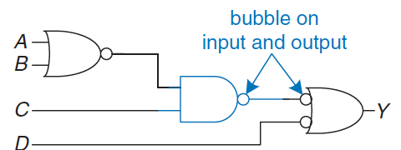
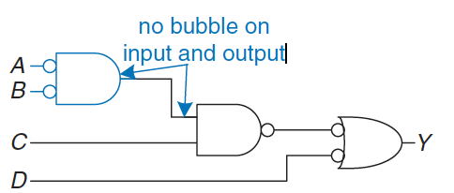
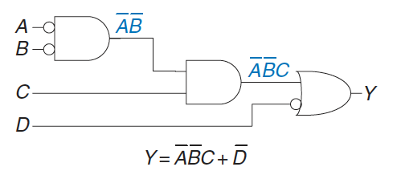
Bubble Pushing
Redraw circuits (with lots of NAND and NOR) so that the function can be more easily determined
Algorithm:
begin at the output of the circuit and work toward the inputs
push bubbles back toward the inputs
we can read the equation in terms of the output instead of its complement
working backward, draw each gate in a form so that bubbles cancel
If the current gate has an input bubble, draw the preceding gate with an output bubble
bubbles in series cancel
Y = ((A+B) C) D

Slide 27
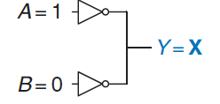
X and Z (1)
Boolean algebra is limited to 0 and 1, real circuits can also have illegal and floating values
X indicates that the circuit node has an unknown or illegal value
commonly happens if it is being driven to both 0 and 1 at the same time
this situation (contention) is an error and must be avoided
the actual voltage of the node may be somewhere between 0 and VDD, depending on the relative strengths of the driving gates
X are also used by circuit simulator to indicate an uninitialized value
Notice: X can indicate “don’t care” values in truth tables
be sure not to mix up the two meanings

Slide 28
X and Z (2)
Z indicates that a node is being driven neither HIGH nor LOW
the node is said to be floating
Typical misconception: a floating node is the same as a logic 0
a floating node might be 0, might be 1, or might be at some voltage in between
A common way to produce a floating node is to forget to connect a voltage to a circuit input
this may cause the circuit to behave erratically, as the floating input randomly changes from 0 to 1
touching the circuit may be enough to trigger the change by means of static electricity from the body
you can see circuits that operate correctly only as long as the student keeps a finger pressed on a chip…

Slide 29
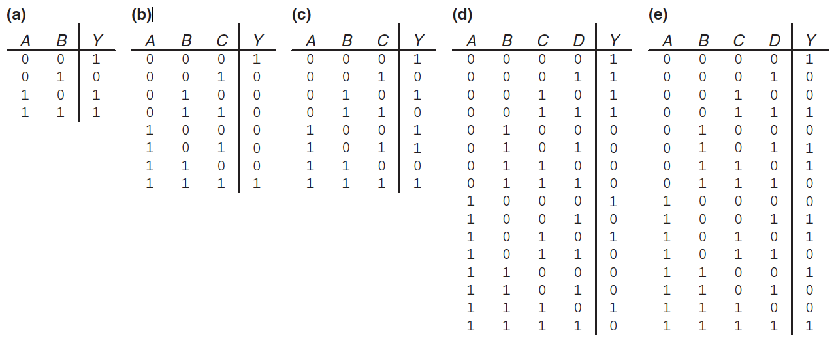
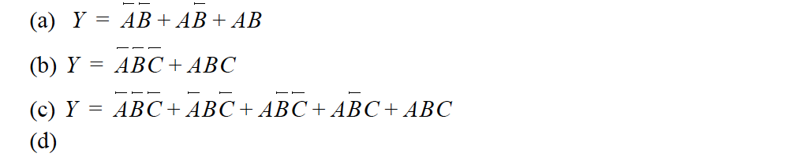

Exercises (1)
Ex5.1: Write a Boolean equation in sum-of-products canonical form for each of the truth tables
Solution:

Slide 30
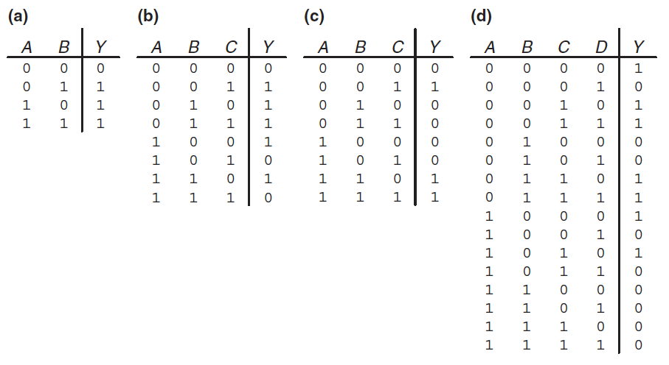
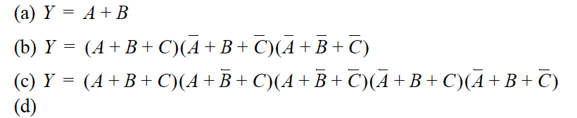
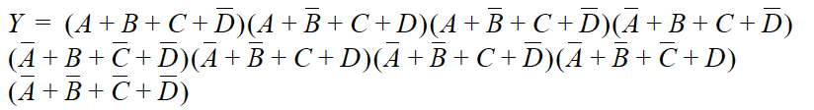
Exercises (2)
Ex5.2: Write a Boolean equation in product-of-sums canonical form for each of the truth tables
Solution:

Slide 31
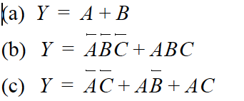

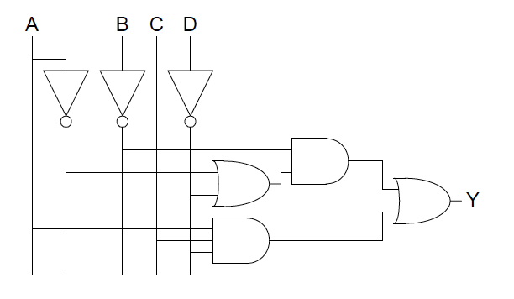
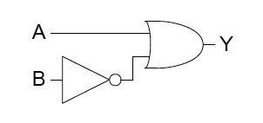


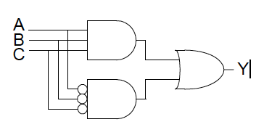

Exercises (3)
Ex5.3: Sketch a reasonably simple combinational circuit implementing each of the following functions. Reasonably simple means that you are not wasteful of gates, but you don’t waste vast amounts of time checking every possible implementation of the circuit either.
Solution:

